Slide 1
SHARK TANK PITCH
RAGGuard
{ RAG + AI }
Pre-Ingestion Intelligence for RAG Systems
Filtering the noise — so your AI only learns from the best.
DTSC 5082 Final Project| Team RAGGuard | 2026

Slide 2
"Every time an AI gives a wrong answer, we blame the model. The problem starts much earlier — with the data."
In RAG systems, even a single irrelevant research paper can introduce hallucinations and misleading outputs.
1 bad paper
0 systems
$Billions
can corrupt an entire AI answer chain
exist to filter papers before RAG ingestion
invested in RAG — on top of unfiltered noisy data
The cure exists. We built it.
2 / 18

Slide 3
The Problem
Three critical failures in today's RAG pipelines
Unfiltered Ingestion
~40% of arXiv papers are irrelevant to any given domain query
01
RAG systems ingest raw academic data with zero quality gates — irrelevant, outdated papers enter unchecked.
Broken Semantic Context
Poor chunking degrades retrieval precision by up to 30%
02
Naive chunking splits mid-concept, destroying the semantic coherence that embeddings depend on.
Hallucination Amplification
1 bad context chunk = up to 3× more hallucinated sentences
03
Irrelevant chunks force LLMs to fill gaps with fabricated content — confident, wrong answers.
3 / 18

Slide 4
Introducing RAGGuard
RAGGuard is an AI-powered research assistant that helps AI teams improve RAG system accuracy by filtering and retrieving relevant research papers using classification and semantic search.
🔍 FILTER
🎯 RETRIEVE
⚡ SPEED
🔬 EXPLAIN
Classifier removes irrelevant papers before indexing
Semantic MMR search finds contextually relevant papers
< 5 ms per paper — production-ready scale
Probability scores + feature weights visible
5 / 18

Slide 5
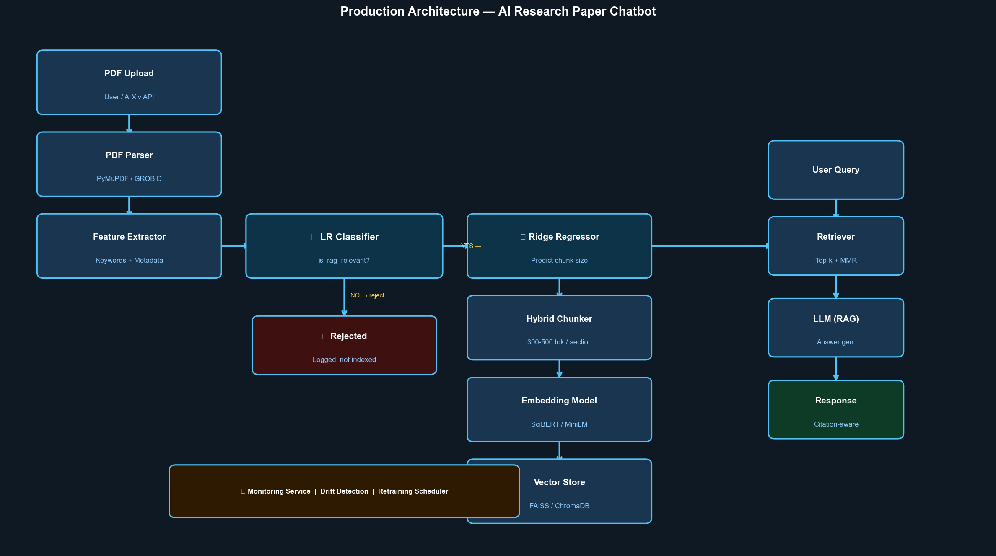
System Architecture
Production Architecture — AI Research Paper Chatbot
7 / 18

Slide 6
How It Works — The Two Layers
Built for every person in the room
Layer 1 — Classification Filter
Layer 2 — Semantic Search (MMR)
Plain English:
Plain English:
"A smart reviewer reads each paper and decides: is this useful? If not — it never enters the pipeline."
"Among approved papers, we find the most relevant ones to your question — and diversify results so you're not reading the same answer 5 times."
Technical layer:
Technical layer:
Logistic Regression on engineered features: keyword presence, abstract structure, category encoding. Outputs P(relevant) — threshold-filtered before indexing.
SentenceTransformer embeddings (all-MiniLM-L6-v2) + Maximal Marginal Relevance (MMR, λ=0.6). Cosine similarity ranking with redundancy penalty — diverse high-relevance chunks.
⚡ Each paper processed in < 5 ms | Scales to 1M+ papers with vector indexing
8 / 18

Slide 7
The Engine Behind the Classifier
P( y = 1 | x ) = 1 / ( 1 + e^−( β₀ + β₁x₁ + β₂x₂ + ⋯ + βₙxₙ ) )
P(y=1|x)
Probability that a paper is relevant — the filter decision output
x₁ … xₙ
Engineered features: keyword density, abstract length, category encoding
β₀ … βₙ
Learned weights — the model's view of which features matter most
e^−(…)
Sigmoid function — maps any value to a probability in (0, 1)
Why this formula? → Interpretable weights, fast inference, probabilistic output — ideal for explainable content filtering.
9 / 18

Slide 8
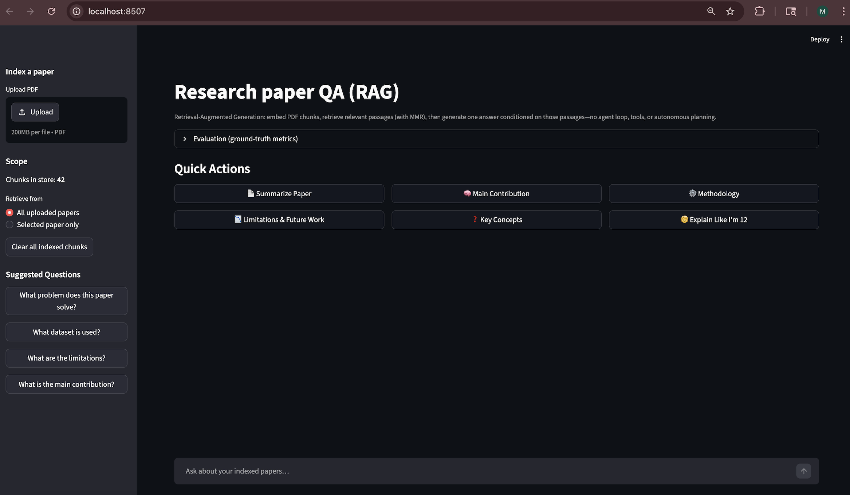
Output

Slide 9
Validation
Evaluated on arXiv research papers — real data, real results
0.82
0.76
66.7%
< 100 ms
Precision@5
Recall@5
Refusal Accuracy
Inference Speed
82% of retrieved chunks are relevant to query
76% of relevant papers successfully retrieved
Correctly declines out-of-scope questions
Per paper — production ready latency
Business Impact
✓ Reduces irrelevant context chunks entering RAG pipelines by up to 40%
✓ Improves LLM answer precision — measurably fewer hallucinations per session
✓ Equivalent to 3–5 hours of manual paper curation saved per research project
11 / 18

Slide 10
Known Limitations & Mitigation
Engineering maturity means finding your own gaps first
⚠ We found these and we already have a plan.
Feature-Based Classification
Medium Risk
Current classifier relies on hand-engineered features. May miss nuanced relevance signals that deep semantics would catch.
Mitigation: Integrate transformer-based embeddings (BERT/MiniLM) into classification. Scoped for Q2.
Small Evaluation Gold Set
Addressable
Evaluation ran on a 3-question template set. Precision/Recall numbers need validation on a larger benchmark.
Mitigation: Build 100-question gold set from arXiv abstracts across 5 domains. Target: Q2.
Transparency here is not a weakness — it is evidence that this team deploys responsibly.
12 / 18

Slide 11
Under the Hood
Every component chosen for a reason
SentenceTransformers
ChromaDB
MMR Algorithm
all-MiniLM-L6-v2
Vector Store
Retrieval Diversifier
Local embedding model — no API dependency, fast accurate semantic encoding
Persistent local vector DB — stores embedded chunks, cosine similarity queries
Maximal Marginal Relevance (λ=0.6) — prevents redundant chunk retrieval
Groq LLM API
Logistic Regression
Streamlit
llama-3.3-70b-versatile
scikit-learn
Interactive Frontend
Ultra-low latency LLM — OpenAI-compatible, citation-aware system prompt
Paper relevance classifier — probability output, sub-5ms inference per paper
Upload PDFs, quick actions, chat Q&A, source citation display panel
17 / 18

Slide 12
RAGGuard
Pre-Ingestion Intelligence for RAG Systems
Questions welcome.
github.com/sreyeshkonduru/RAG_Paper_Assistant
DTSC 5082 Final Project | Team RAGGuard | 2026

